Slide 1



Process Mining
Tools and techniques for the discovery of “real” business processes
1 April 2021
PhD. Fabrizio Fornari
Emerging Topics in Business Information Systems

Slide 2
Agenda
Introduction
Business Process Management Overview
Business Process Management life cycle
The role of Process Mining in the BPM life cycle
The wh questions of Process Mining
The three basic types of Process Mining
How to conduct a Process mining project
Some Process Mining Tools
How to apply Process Mining?
Research Questions Recap
Two words on the discarded questions
References

Slide 3

Who is Fabrizio Fornari?
Since 2020 Postdoc in Computer Science at UNICAM
2018 PhD title in Computer Science at UNICAM. 3 months in Brisbane Queensland University of Technology (Australia)
2012-2013 Master’s degree in Computer Science at UNICAM and University of Reykjavik (Iceland)
2010-2011 Bachelor degree in Computer Science at UNICAM

Slide 4
Where do I work?
University of Camerino (Italy) https://www.unicam.it/
Computer Science Department https://computerscience.unicam.it/
PROS Lab - PROcesses and Services Laboratory http://pros.unicam.it/
University of Camerino, Computer Science Department 2 Google Maps

Slide 5

Teaching Activities
2020-2021
Software Project Management Laboratory at “University of Camerino”, Department of Computer Science (6CFU)
2019-2020
Computer Science at “Università di Macerata”, Faculty of “Economia e diritto” (6CFU)
2018-2019
Computer Science at “Università di Macerata”, Faculty of “Economia e diritto” (6CFU)
Software Project Management Laboratory at “University of Camerino”, Department of Computer Science (3CFU)
I also supervise students projects and thesis
Notes:
I also supervise students with projects and thesis

Slide 6

My Research Interests
Business Process Management
Business Process Modeling and Verification
Business Process and IoT
Process Mining
Developed Tools
BProVe, Business Process Verifier
BEBoP, understandaBility vErifier for Business Process models
RePROSitory, Repository of open PROcess modelS

Slide 7
Business Process Management Overview
What is BPM?
Business Process Management can be defined as the set of all management activities that focuses on improving company’s performance by managing and optimising its business processes. This, with a focus on concepts, methods and activities to support business processes life-cycles.
Revisited version of: “Mathias Weske. Business process management : concepts, methods, technology. Springer, 2007”.

Slide 8
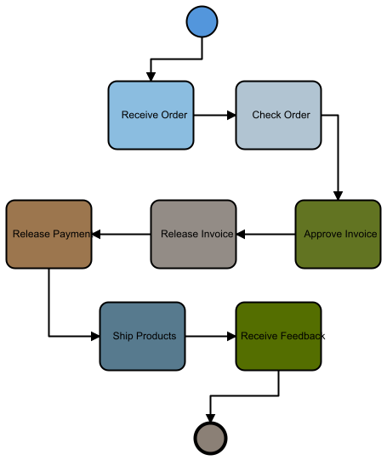
Business Process Management Overview
What is a Business Process (BP)?
A business process is a collection of activities that takes one or more kinds of input and creates an output (a product or a service) that is of value to the customer.
The main innovation is the shift of focus on the business logic of the process (how work is done), instead of the product perspective (what is done).
Hammer, M., & Champy, J. (2009). Reengineering the Corporation: Manifesto for Business Revolution, A. Zondervan.

Slide 9
The BPM Life-Cycle
Process identification
A set of phases in which the management of a business process can be divided.
Process discovery
Process
monitoring and controlling
Process
analysis
Process
implementation
Process
redesign
Marlon Dumas, M. L. R., & Jan Mendling, H. A. R. (2018). Fundamentals of Business Process Management.

Slide 10
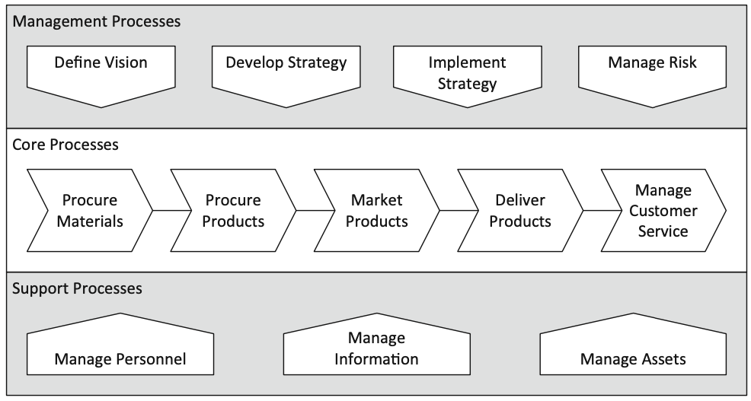
Process Identification
Process identification
Process Architecture
It includes management activities that aim to define the set of business processes of an organization and establish clear criteria for selecting specific processes for improvement.
Process discovery
The output of process identification is a process architecture, which represents the processes and their interrelations.
This architecture is then used to select which process or set thereof to manage through the remaining phases of the lifecycle.
Process
monitoring and controlling
Process
analysis
Process
implementation
Process
redesign

Slide 11
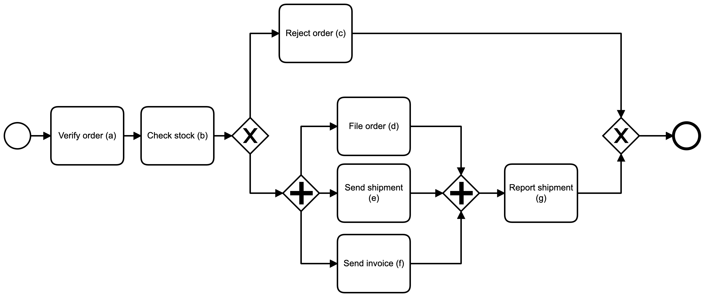
Process Discovery
Process identification
In this phase the current state of each of the relevant processes is documented, in the form of one (or more) as-is process model.
Process discovery
As-is process model
Why modelling a BP?
To understand the process and to share our understanding of the process with the people who deal with it on a daily basis
Process
monitoring and controlling
Process
analysis
Designed by interviewing process participants or by observing how they operate in practice.
The model must be syntactically correct, and it also must accurately reflects the actual business process being modeled.
Process
implementation
Process
redesign
Models are prerequisite to conduct the next BP life-cycle phases.

Slide 12
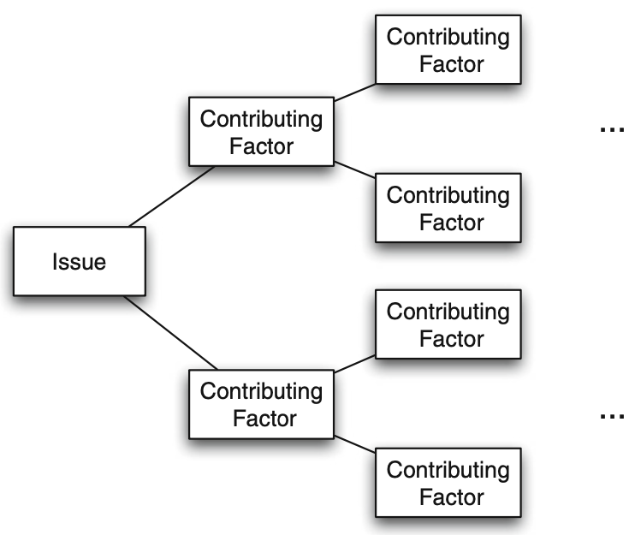
Process Analysis
Process identification
In this phase, issues associated with the as-is process are identified and documented.
Process discovery
The output of this phase is a structured collection of issues.
Qualitative Analysis
Process
monitoring and controlling
Process
analysis
Insights on
issues and their impact
Process
implementation
Process
redesign

Slide 13
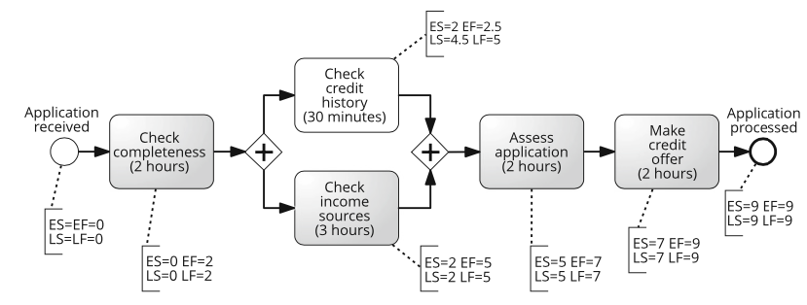
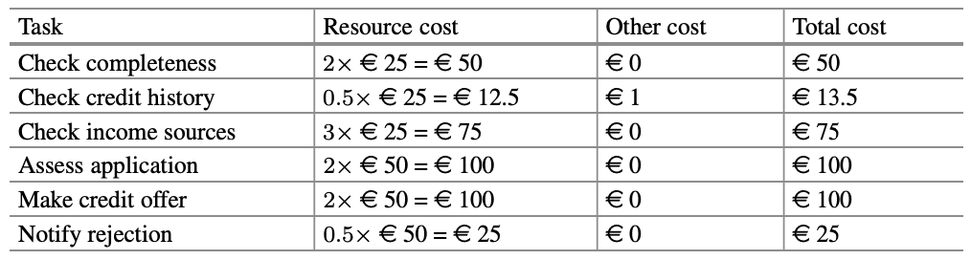
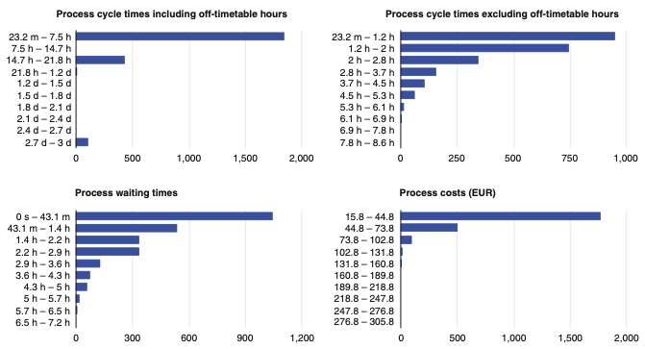
Process Analysis
Process identification
Quantitative Analysis
The analysis of measure used to desribe a process. Such as: Raw Material cost. Resource cost, Time to perform an activity, Time to perform the entire process, etc.
Process discovery
Process
monitoring and controlling
Process
analysis
We can use Simulation to estimate costs and variations based on hypothetical changes.
total cost-per-execution of the process
50/(1−0.2)+13.5+75+100+0.6×100+0.4×25 = 321€
Quantitative estimations
Process
implementation
Process
redesign

Slide 14
Process Redesign
Process identification
To identify changes to the process that would help to address the issues identified in the previous phase and allow the organization to meet its performance objectives.
Process redesign and process analysis go hand-in-hand. As new change options are proposed, they are analyzed using process analysis techniques. Eventually, the most promising change options are retained and combined into a redesigned process.
The output of this phase is typically a to-be process model.
Process discovery
Process
monitoring and controlling
Process
analysis
Process
implementation
Process
redesign
To-be
proces model

Slide 15
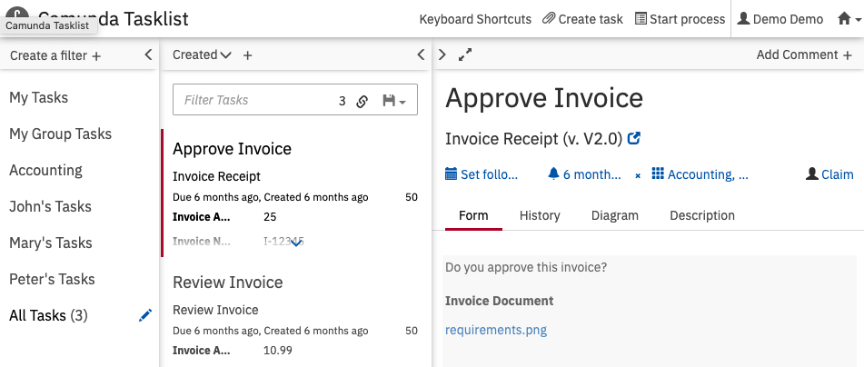
Process Implementation
Process identification
The changes required to move from the as-is process to the to-be process are prepared and performed.
Process discovery
Process implementation covers two aspects: organizational change management and automation.
Process
monitoring and controlling
Process
analysis
Executable process model/change management plan
Process
implementation
Process
redesign
Notes:
Organizational change management refers to the set of activities required to change the way of working of all participants involved in the process.
Process automation refers to the development and deployment of IT systems (or enhanced versions of existing IT systems) that support the to-be process.

Slide 16
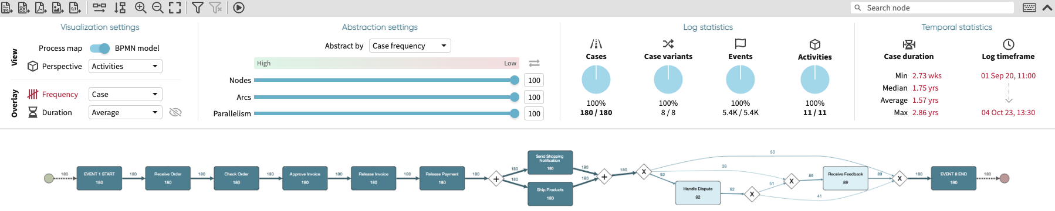
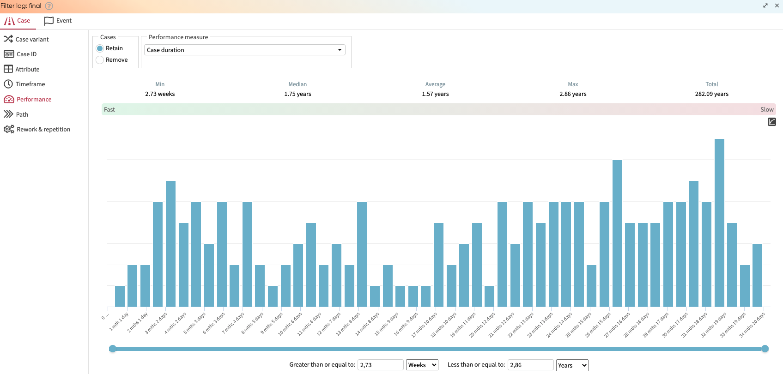
Process Monitoring and Controlling
Process identification
Relevant data are collected and analyzed to determine how well the process is performing.
Bottlenecks, recurrent errors, or deviations are identified and corrective actions are undertaken.
Process discovery
Conformance and performance insights
Process
monitoring and controlling
Process
analysis
Process
implementation
Process
redesign

Slide 17
Process identification
Overall BP life-cycle
Process Architecture
New issues may then arise, in the same or in other processes, which requires the cycle to be repeated on a continuous basis.
Process discovery
As-is process model
Conformance and performance insights
Process
monitoring and controlling
Process
analysis
Where is Process Mining?
Executable process model/change management plan
Quantitative estimations
Process
implementation
Process
redesign
To-be proces model
Notes:
Can you guess?

Slide 18
Process Mining?
Picture by
Koen Olsthoorn
Notes:
http://www.olifantenpaadjes.nl/wp-content/uploads/2011/06/Koen-Olsthoorn.jpg

Slide 19
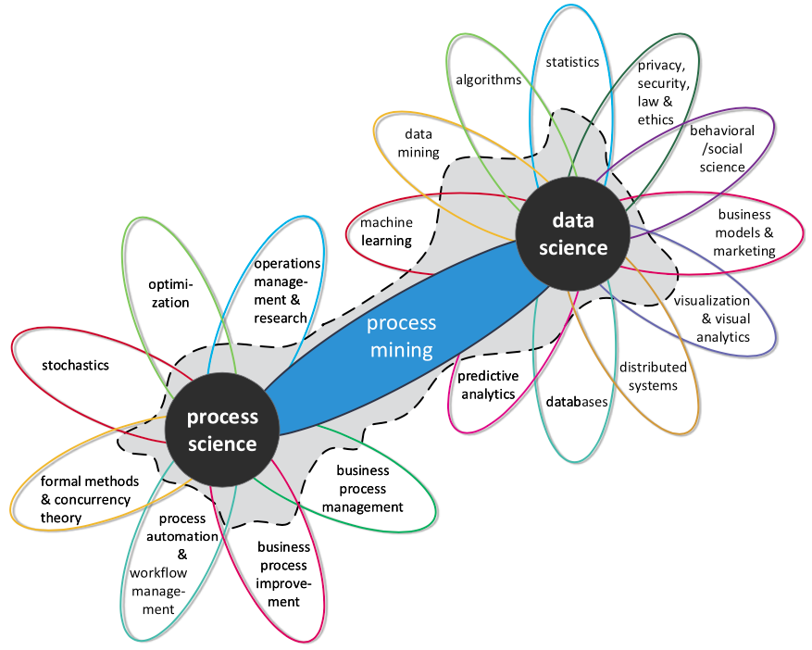
What is Process Mining?
Process mining is a family of techniques linking data science and process management to support the analysis of operational processes based on event logs.
The goal of process mining is to turn event data into insights and actions. Process mining is an integral part of data science, fueled by the availability of data and the desire to improve processes.
E.g., process mining uses event data to automatically discover a process model by observing events recorded by some enterprise system
Van Der Aalst, W., Adriansyah, A., De Medeiros, A. K. A., Arcieri, F., Baier, T., Blickle, T., ... & Wynn, M. (2011, August). Process mining manifesto. In International Conference on Business Process Management (pp. 169-194). Springer, Berlin, Heidelberg.
Notes:
Van Der Aalst, W. (2012). Process mining: Overview and opportunities. ACM Transactions on Management Information Systems (TMIS), 3(2), 1-17.

Slide 20
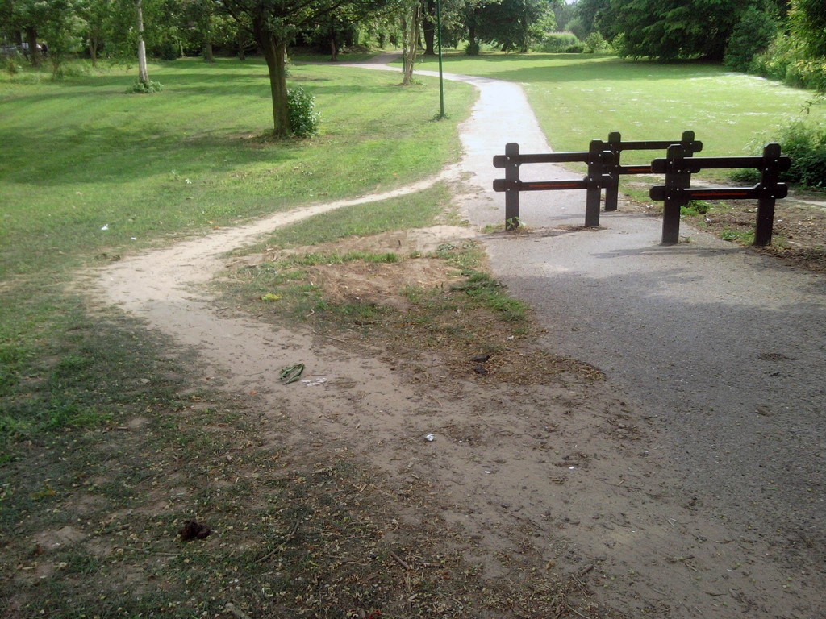
What happens when we do Process Mining?
We can find the actual process is different from the one we designed!
Picture by
Koen Olsthoorn
Notes:
http://www.olifantenpaadjes.nl/wp-content/uploads/2011/06/Koen-Olsthoorn.jpg

Slide 21
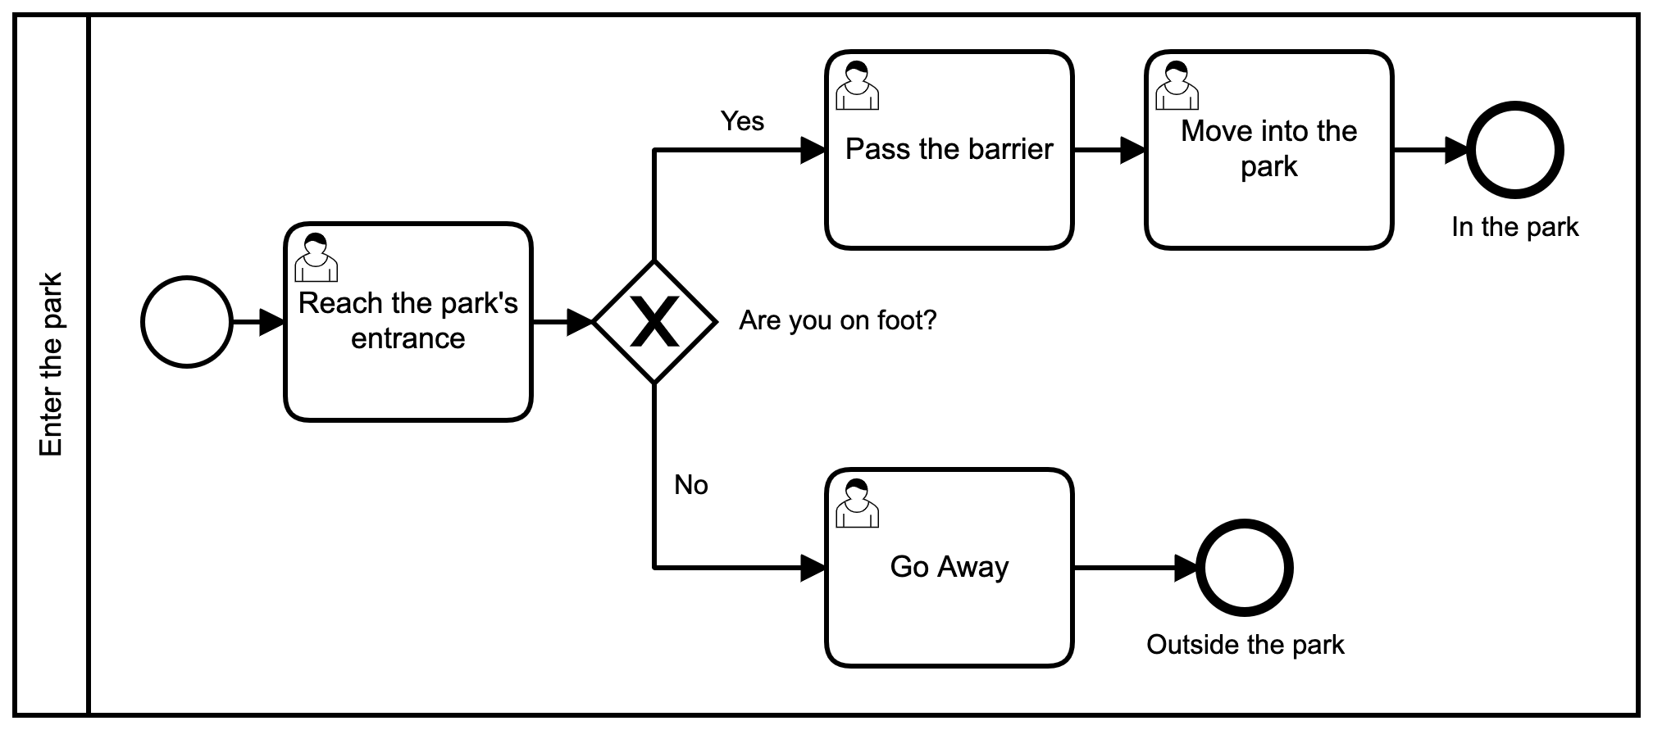
What happens when we do Process Mining?
The perfectly designed model
Picture by
Koen Olsthoorn
Notes:
http://www.olifantenpaadjes.nl/wp-content/uploads/2011/06/Koen-Olsthoorn.jpg

Slide 22
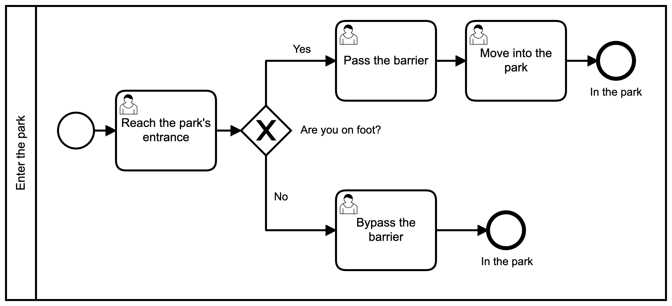
What happens when we do Process Mining?
The model that reflects reality
Picture by
Koen Olsthoorn
Notes:
http://www.olifantenpaadjes.nl/wp-content/uploads/2011/06/Koen-Olsthoorn.jpg

Slide 23
What allowed us to spot a process deviation?
The traces, right?!
Picture by
Koen Olsthoorn
Notes:
http://www.olifantenpaadjes.nl/wp-content/uploads/2011/06/Koen-Olsthoorn.jpg

Slide 24
Let’s start from the traces!
For humans, Footprints represent the path we took, what we have done, or someone else has done.
In BPM, especially supported by an informatic system, we talk about event logs.
Case ID | Activity | Start Date | End Date | Agent Position | Customer ID | Product | Service Type | Resource
Case 1 | Inbound Call | 9.3.10 8:05 | 9.3.10 8:10 | FL | Customer 1 | MacBook Pro | Referred to Servicer | Helen
Case 1 | Handle Case | 11.3.10 10:30 | 11.3.10 10:32 | FL | Customer 1 | MacBook Pro | Referred to Servicer | Helen
Case 1 | Call Outbound | 11.3.10 11:45 | 11.3.10 11:52 | FL | Customer 1 | MacBook Pro | Referred to Servicer | Henk
Case 2 | Inbound Call | 4.3.10 11:43 | 4.3.10 11:46 | FL | Customer 2 | MacBook Pro | Referred to Servicer | Susi
Case 3 | Inbound Call | 25.3.10 9:32 | 25.3.10 9:33 | FL | Customer 3 | MacBook Pro | Referred to Servicer | Mary
Case 4 | Inbound Call | 6.3.10 11:41 | 6.3.10 11:51 | FL | Customer 4 | iPhone | Referred to Servicer | Fred
Case 5 | Inbound Call | 18.3.10 10:54 | 18.3.10 11:01 | FL | Customer 5 | MacBook Pro | Product Assistance | Kenny
Case 6 | Inbound Call | 25.3.10 17:09 | 25.3.10 17:13 | FL | Customer 6 | MacBook Pro | Referred to Servicer | Harold
Process Mining Tool
Notes:
Van Der Aalst, W. (2012). Process mining: Overview and opportunities. ACM Transactions on Management Information Systems (TMIS), 3(2), 1-17.

Slide 25
Event log
An event log is a registry of all the events, related to a business process, that a company is recording.
An event log consists of cases and cases consist of events. The events for a case are represented in the form of a trace, i.e., a sequence of unique events.
Ordered by Time
Ordered by Case ID
Case ID | Activity | time:timestamp
40 | Receive Order | 30/11/2020 14:03
41 | Receive Order | 30/11/2020 14:05
40 | Check Order | 08/12/2020 14:03
41 | Check Order | 08/12/2020 14:06
40 | Approve Invoice | 29/12/2020 14:57
41 | Approve Invoice | 29/12/2020 14:59
40 | Release Invoice | 28/01/2021 11:15
41 | Release Invoice | 28/01/2021 11:17
41 | Release Payment | 20/02/2021 12:40
40 | Release Payment | 24/02/2021 12:39
40 | Ship Products | 24/02/2021 12:40
40 | Send Shipping Notification | 24/02/2021 12:50
41 | Send Shipping Notification | 26/02/2021 10:39
41 | Ship Products | 26/02/2021 17:02
41 | Receive Feedback | 06/03/2021 14:38
Case ID | Activity | time:timestamp
40 | Receive Order | 30/11/2020 14:03
40 | Check Order | 08/12/2020 14:03
40 | Approve Invoice | 29/12/2020 14:57
40 | Release Invoice | 28/01/2021 11:15
40 | Release Payment | 24/02/2021 12:39
40 | Ship Products | 24/02/2021 12:40
40 | Send Shipping Notification | 24/02/2021 12:50
41 | Receive Order | 30/11/2020 14:05
41 | Check Order | 08/12/2020 14:06
41 | Approve Invoice | 29/12/2020 14:59
41 | Release Invoice | 28/01/2021 11:17
41 | Release Payment | 20/02/2021 12:40
41 | Send Shipping Notification | 26/02/2021 10:39
41 | Ship Products | 26/02/2021 17:02
41 | Receive Feedback | 06/03/2021 14:38
Time
Case 40
Time
Case 41
time
Notes:
Minimum requirement for event log

Slide 26



















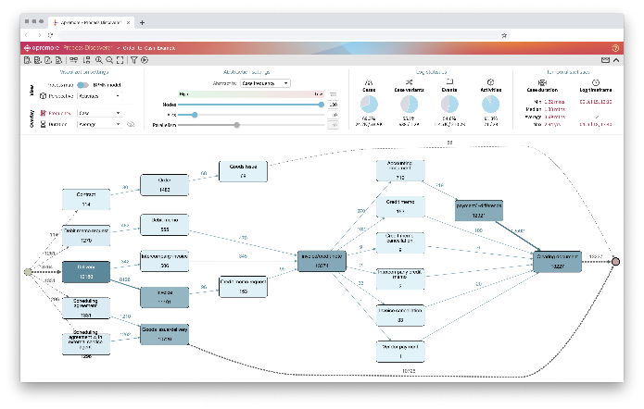


From Raw Data to Process Mining
Four steps are necessary to apply process mining techniques:
01
Every process leaves digital footprints. The corresponding IT systems for each process must be identified to utilize the data.
Digital Footprint
02
Data is extracted and transformed into event logs. The quality of the data is fundamental to obtain reliable results.
Data Collection
03
The event log can be prepared by consolidating different data sources and assigning a semantics to each data attribute.
Data Preparation
04
The event log is then ready to be consumed by process mining techniques such as automated discovery and performance mining.
Process Mining
Copyright 2020 Apromore Pty Ltd

Slide 27
Why Process Mining?
Data matters,
only if we are able to extract useful information out of it.
In our case, we are speaking about information that affect Business Processes of Companies.
To gather valuable information (out of our stored process data) that can influence the reorganization of processes for improving their performance and/or for complying with some regulations.
Notes:
Van Der Aalst, W. (2012). Process mining: Overview and opportunities. ACM Transactions on Management Information Systems (TMIS), 3(2), 1-17.

Slide 28
Where in the BP life-cycle?
Process identification
Process Architecture
Process Mining is here!
Process Mining:
From event logs of executed processes
To conformance and performance insights
Process discovery
As-is process model
Conformance and performance insights
Process
monitoring and controlling
Process
analysis
Event logs of executed processes
Quantitative estimations
Process
implementation
Process
redesign
To-be proces model

Slide 29
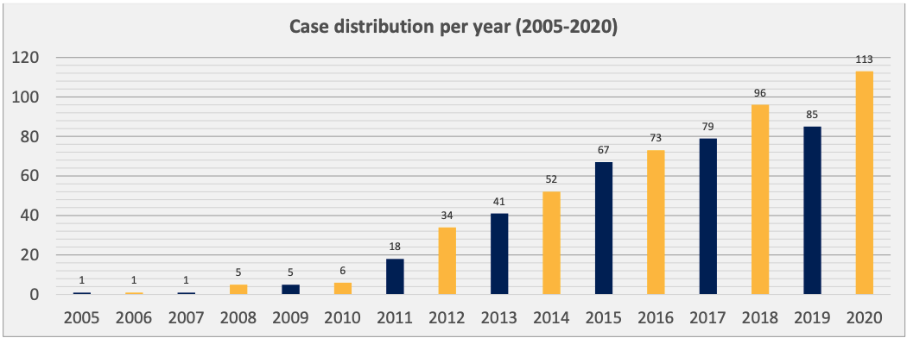
When Process Mining?
Van Der Aalst, W., Adriansyah, A., De Medeiros, A. K. A., Arcieri, F., Baier, T., Blickle, T., ... & Wynn, M. (2011, August). Process mining manifesto. In International Conference on Business Process Management (pp. 169-194). Springer, Berlin, Heidelberg.
Process mining: a database of applications. Technical report, HSPI SpA-Management Consulting. 2021
Notes:
Van Der Aalst, W. (2012). Process mining: Overview and opportunities. ACM Transactions on Management Information Systems (TMIS), 3(2), 1-17.

Slide 30
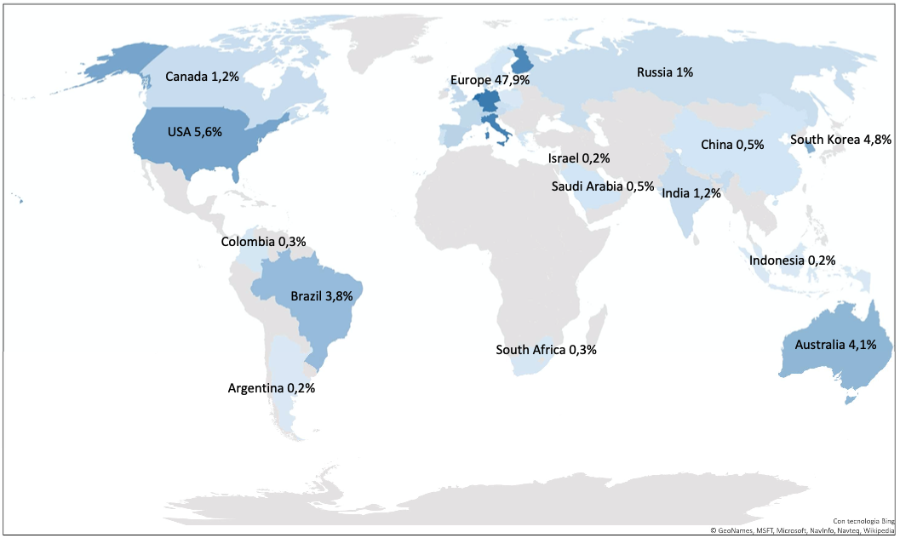
Where is Process Mining done?
Process mining: a database of applications. Technical report, HSPI SpA-Management Consulting. 2021

Slide 31
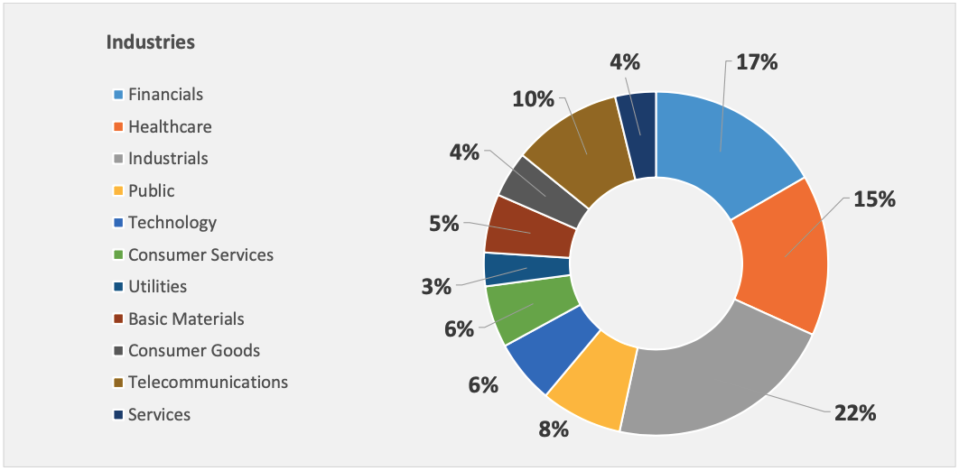
Where is Process Mining done?
Process mining: a database of applications. Technical report, HSPI SpA-Management Consulting. 2021

Slide 32
Who is using Process Mining?
Automotive & Parts (Italy) Accounts Payble
Goals: Monitor Account Management dynamics; Discover and analyze process inefficiencies; Reduce invoice processing time, by reducing the inefficient activities; Analyze and Monitor the payment behavior.
Results: Exposed the critical suppliers relative to the processing time; Identified all inefficient activities and bottlenecks; Implemented the continuous monitoring of the account payable process.
Waste Management (France) Procure to Pay (P2P)
Goals: Ensure that suppliers are paid within a reasonable period based on the Sapin regulation in France. If this regulation is not respected, high penalties have to be paid. To avoid this kind of financial risks, it is necessary to identify where P2P loses time (late payments) and low automation
They use process mining to discover process violation regarding P2P and accounts payables, discover non complaint process behaviors with the help of conformance check and monitor P2P and payment related issues
Process mining: a database of applications. Technical report, HSPI SpA-Management Consulting. 2020

Slide 33
Who is using Process Mining?
Healthcare Facilities, Services & Equipment UW Health (United States)
Process improvement, decision support UW Health is a large academic medical center associated with the University of Wisconsin-Madison located in Midwestern United States. More than 600,000 patients are served annually at 7 hospitals and 87 outpatient clinics.
The case study shows the challenges and successes of introducing process mining to UW Health. She also demonstrates how process mining was used to analyze the flow of urgent and emergent surgical cases added to the schedule and how this technology provided a new way of using the data.
Banking Komercni banka (Czech) Finance
Visualization of processes.
Lead time improvement.
Process statistics with root cause analysis.
Combining data across variety of systems for an end-to-end view.
Process mining: a database of applications. Technical report, HSPI SpA-Management Consulting. 2020

Slide 34
How is Process Mining done?
Van Der Aalst, W., Adriansyah, A., De Medeiros, A. K. A., Arcieri, F., Baier, T., Blickle, T., ... & Wynn, M. (2011, August). Process mining manifesto. In International Conference on Business Process Management (pp. 169-194). Springer, Berlin, Heidelberg.
Notes:
Van Der Aalst, W. (2012). Process mining: Overview and opportunities. ACM Transactions on Management Information Systems (TMIS), 3(2), 1-17.

Slide 35
The three basic types of Process Mining
Discovery – A Business Process model is discovered from an event log
Conformance - An existing model is compared with its event log and discrepancies between the log and the model are analysed.
Enhancement – An existing model is extended/modified, so to improve the existing model and the Business Process represented.
Van Der Aalst, W., Adriansyah, A., De Medeiros, A. K. A., Arcieri, F., Baier, T., Blickle, T., ... & Wynn, M. (2011, August). Process mining manifesto. In International Conference on Business Process Management (pp. 169-194). Springer, Berlin, Heidelberg.

Slide 36
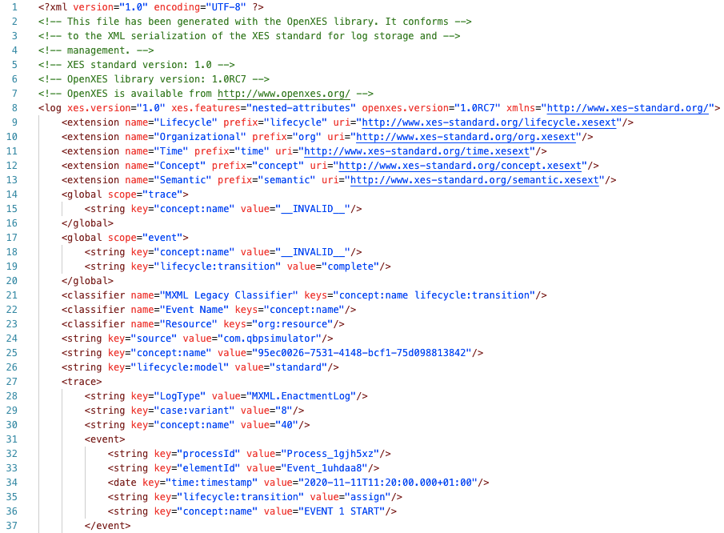
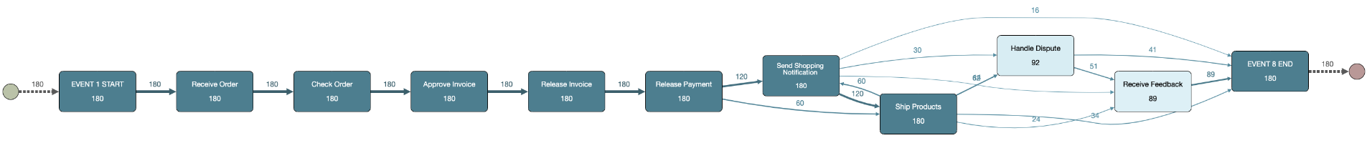
The three basic types of Process Mining
Discovery – A Business Process model is discovered from an event log
IEEE Standard for eXtensible Event Stream (XES)
https://xes-standard.org/
From
To

Slide 37
Process Models
Process Maps (aka Directly Follow Graph)
BPMN Model
Business Process Model and Notation (BPMN) https://www.omg.org/spec/BPMN/2.0.2/PDF

Slide 38
BPMN - Core
Business Process Model and Notation (BPMN) https://www.omg.org/spec/BPMN/2.0.2/PDF

Slide 39
How does Process Discovery work?
Case ID | Activity | Timestamp
40 | Receive Order | 30/11/2020 14:03
40 | Check Order | 08/12/2020 14:03
40 | Approve Invoice | 10/12/2020 14:57
40 | Release Invoice | 15/01/2021 11:15
40 | Release Payment | 02/02/2021 12:39
40 | Ship Products | 10/02/2021 14:39
40 | Send Shipping Notification | 10/03/2021 16:39
41 | Receive Order | 11/04/2021 14:05
41 | Check Order | 12/04/2021 14:06
41 | Approve Invoice | 13/04/2021 14:59
41 | Release Invoice | 14/04/2021 11:17
41 | Release Payment | 15/04/2021 12:40
41 | Send Shipping Notification | 31/04/2021 10:02
41 | Ship Products | 31/04/2021 10:50
41 | Receive Feedback | 06/05/2021 14:38
Process
Instance
ID 40
Process
Instance
ID 41

Slide 40

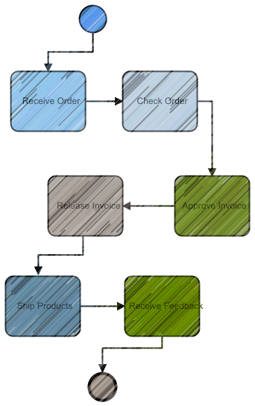
How does Process Discovery work?
Case ID | Activity | Timestamp
40 | Receive Order | 30/11/2020 14:03
40 | Check Order | 08/12/2020 14:03
40 | Approve Invoice | 10/12/2020 14:57
40 | Release Invoice | 15/01/2021 11:15
40 | Release Payment | 02/02/2021 12:39
40 | Ship Products | 10/02/2021 14:39
40 | Send Shipping Notification | 10/03/2021 16:39
41 | Receive Order | 11/04/2021 14:05
41 | Check Order | 12/04/2021 14:06
41 | Approve Invoice | 13/04/2021 14:59
41 | Release Invoice | 14/04/2021 11:17
41 | Release Payment | 15/04/2021 12:40
41 | Send Shipping Notification | 31/04/2021 10:02
41 | Ship Products | 31/04/2021 10:50
41 | Receive Feedback | 06/05/2021 14:38
Process
Instance
ID 40
Process
Instance
ID 41

Slide 41
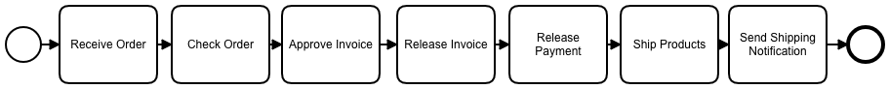
How does Process Discovery work?
Case ID | Activity | Timestamp
40 | Receive Order | 30/11/2020 14:03
40 | Check Order | 08/12/2020 14:03
40 | Approve Invoice | 10/12/2020 14:57
40 | Release Invoice | 15/01/2021 11:15
40 | Release Payment | 02/02/2021 12:39
40 | Ship Products | 10/02/2021 14:39
40 | Send Shipping Notification | 10/03/2021 16:39
Process Instance ID 40
Process Instance ID 41
41 | Receive Order | 11/04/2021 14:05
41 | Check Order | 12/04/2021 14:06
41 | Approve Invoice | 13/04/2021 14:59
41 | Release Invoice | 14/04/2021 11:17
41 | Release Payment | 15/04/2021 12:40
41 | Send Shipping Notification | 31/04/2021 10:02
41 | Ship Products | 31/04/2021 10:50
41 | Receive Feedback | 06/05/2021 14:38

Slide 42
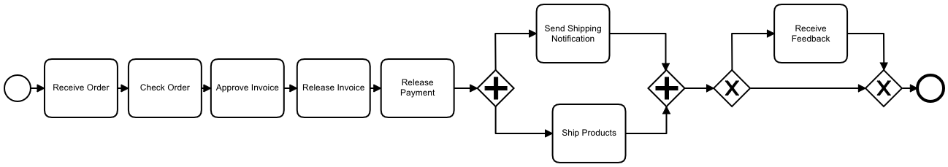
How does Process Discovery work?
Discovered Process Model
Case ID | Activity | Timestamp
40 | Receive Order | 30/11/2020 14:03
40 | Check Order | 08/12/2020 14:03
40 | Approve Invoice | 10/12/2020 14:57
40 | Release Invoice | 15/01/2021 11:15
40 | Release Payment | 02/02/2021 12:39
40 | Ship Products | 10/02/2021 14:39
40 | Send Shipping Notification | 10/03/2021 16:39
41 | Receive Order | 11/04/2021 14:05
41 | Check Order | 12/04/2021 14:06
41 | Approve Invoice | 13/04/2021 14:59
41 | Release Invoice | 14/04/2021 11:17
41 | Release Payment | 15/04/2021 12:40
41 | Send Shipping Notification | 31/04/2021 10:02
41 | Ship Products | 31/04/2021 10:50
41 | Receive Feedback | 06/05/2021 14:38

Slide 43
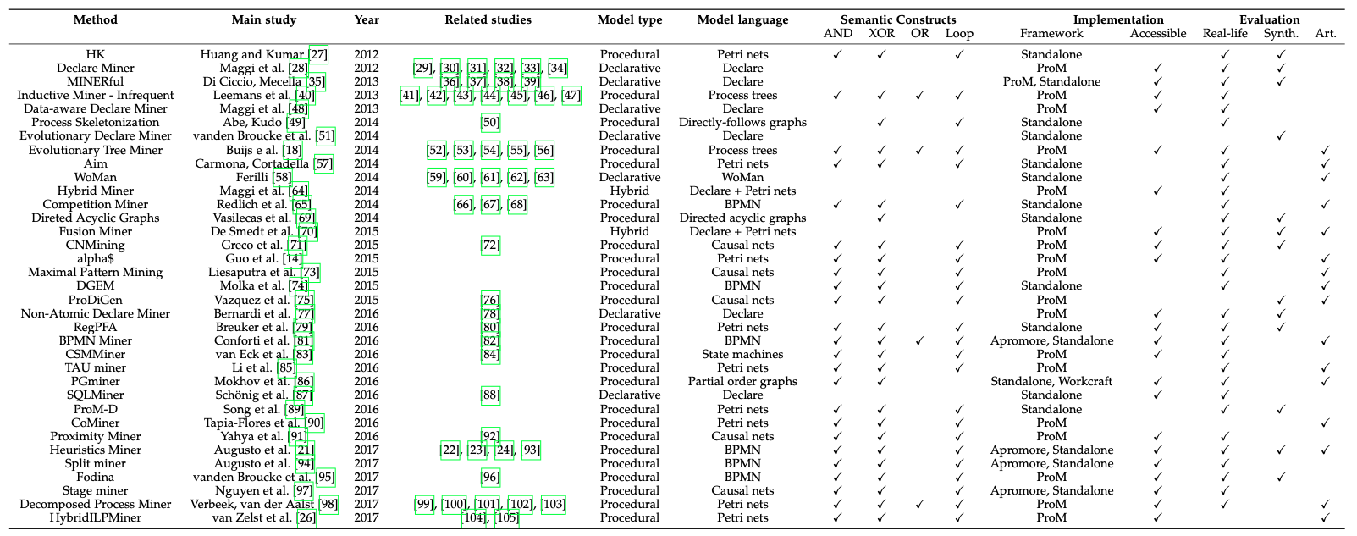
Process Mining Algorithms
Augusto, A., Conforti, R., Dumas, M., La Rosa, M., Maggi, F. M., Marrella, A., ... & Soo, A. (2018). Automated discovery of process models from event logs: Review and benchmark. IEEE transactions on knowledge and data engineering, 31(4), 686-705.
Notes:
Wi will not go into the technical details

Slide 44
Four quality dimensions
«ability to replay the event log»
Fitness
«not overfitting the log»
Generalization
Precision
«not underfitting the log»
Simplicity
Slightly revised from: Van Der Aalst, W. (2016). Data science in action. In Process mining (pp. 3-23). Springer, Berlin, Heidelberg
«the simplest model is usually the right one*»
* Occam’s Razor
Notes:
«ability to explain the observed behavior»
four quality dimensions fitness, simplicity, precision, and generalization
Occam’s razor: the simplest model that can explain the behavior seen in the log, is the best model

Slide 45
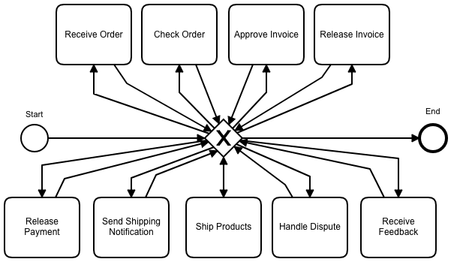
Four quality dimensions?
A Flower Model
Case ID | Activity | Timestamp
40 | Receive Order | 30/11/2020 14:03
40 | Check Order | 08/12/2020 14:03
40 | Approve Invoice | 10/12/2020 14:57
40 | Release Invoice | 15/01/2021 11:15
40 | Release Payment | 02/02/2021 12:39
40 | Ship Products | 10/02/2021 14:39
40 | Send Shipping Notification | 10/03/2021 16:39
41 | Receive Order | 11/04/2021 14:05
41 | Check Order | 12/04/2021 14:06
41 | Approve Invoice | 13/04/2021 14:59
41 | Release Invoice | 14/04/2021 11:17
41 | Release Payment | 15/04/2021 12:40
41 | Send Shipping Notification | 31/04/2021 10:02
41 | Ship Products | 31/04/2021 10:50
41 | Receive Feedback | 06/05/2021 14:38
Fitness?
Precision?
Generalization?
Simplicity?

Slide 46
Four quality dimensions?
Case ID | Activity | Timestamp
40 | Receive Order | 30/11/2020 14:03
40 | Check Order | 08/12/2020 14:03
40 | Approve Invoice | 10/12/2020 14:57
40 | Release Invoice | 15/01/2021 11:15
40 | Release Payment | 02/02/2021 12:39
40 | Ship Products | 10/02/2021 14:39
40 | Send Shipping Notification | 10/03/2021 16:39
41 | Receive Order | 11/04/2021 14:05
41 | Check Order | 12/04/2021 14:06
41 | Approve Invoice | 13/04/2021 14:59
41 | Release Invoice | 14/04/2021 11:17
41 | Release Payment | 15/04/2021 12:40
41 | Send Shipping Notification | 31/04/2021 10:02
41 | Ship Products | 31/04/2021 10:50
41 | Receive Feedback | 06/05/2021 14:38
Fitness?
Precision?
Generalization?
Simplicity?

Slide 47
Process Conformance
A Model (it can be a «Normative Model»)
Actual Event Log
42 | Receive Order | 11/04/2021 14:05
42 | Check Order | 12/04/2021 14:06
42 | Approve Invoice | 13/04/2021 14:59
42 | Release Invoice | 14/04/2021 11:17
42 | Release Payment | 15/04/2021 12:40
42 | Send Shipping Notification | 31/04/2021 10:02
42 | Handle Dispute | 06/06/2021 14:38
42 | Receive Feedback | 07/06/2021 10:50

Slide 48
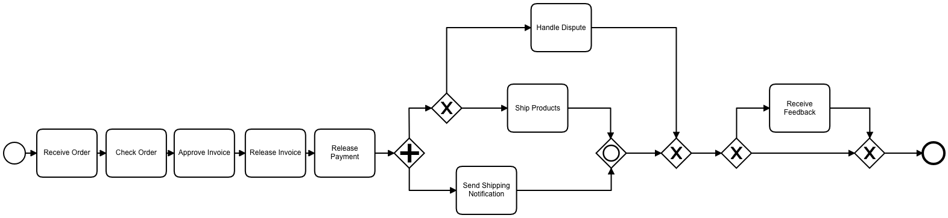
Process Conformance
Our Model
Discovered Model
Notes:
Maximum Precision

Slide 49

Process Enhancement
Enhancement – An existing model is extended/modified, using information about the actual process recorded in some event log, so to improve the existing model and the Business Process represented.
Enhancement Types
repair, i.e., modifying the model to better reflect reality. For example, if two activities are modeled sequentially but in reality can happen in any order, then the model may be corrected to reflect this.
extension, i.e., adding a new perspective to the process model by cross-correlating it with the log. E.g., the extension of a process model with performance data. For instance it can be extended with information about resources, decision rules, quality metrics, costs, etc.

Slide 50
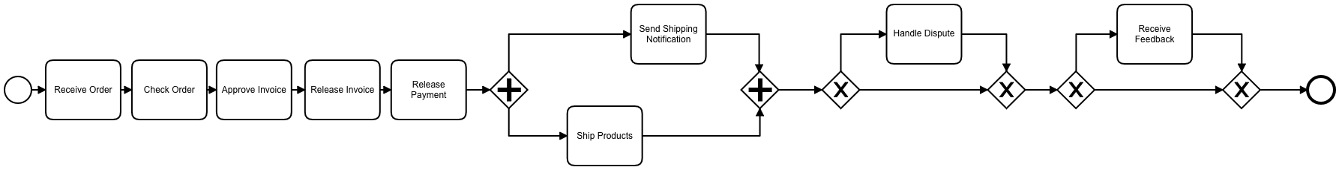
Process Repair
Normative Model
Discovered Model
Repaired Model
Notes:
Starting from what we found after the Conformance check
The repaired model can be input for simulation o implementation

Slide 51
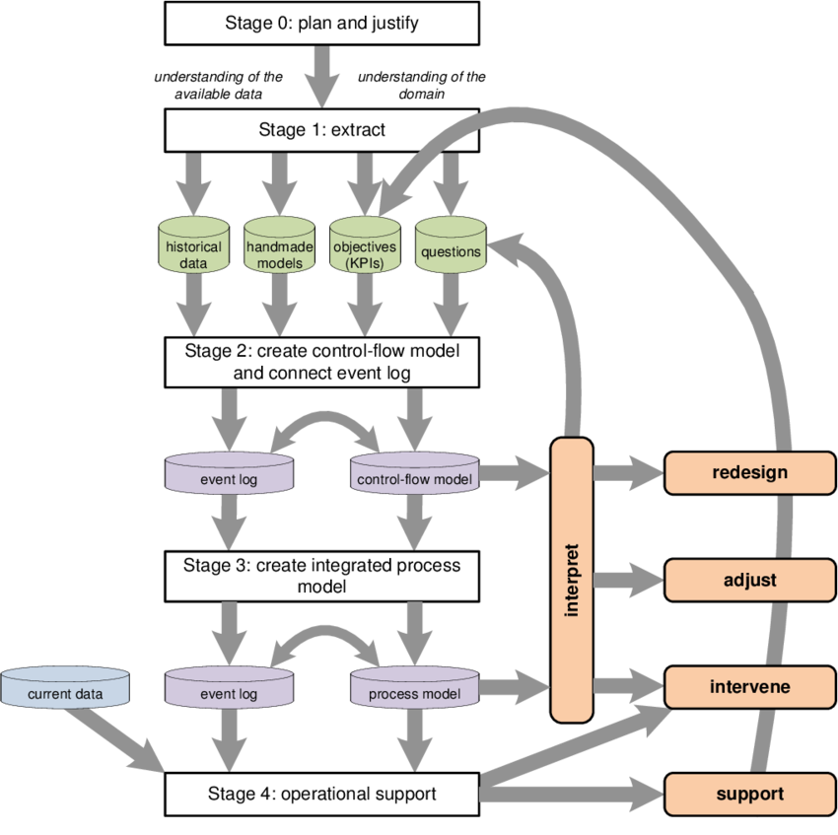
How does a process mining project actually works?
Stage 0: plan and justiy
Stage 1: extract
Stage 2: create control-flow model and connect event log
Stage 3: create integrated process model
Stage 4: operational support
Van Der Aalst, W., Adriansyah, A., De Medeiros, A. K. A., Arcieri, F., Baier, T., Blickle, T., ... & Wynn, M. (2011, August). Process mining manifesto. In International Conference on Business Process Management (pp. 169-194). Springer, Berlin, Heidelberg.
Notes:
Extract data, models, questions, objectives
Discovery of process model, Event log may be filtered

Slide 52
Process Mining
Van Der Aalst, W., Adriansyah, A., De Medeiros, A. K. A., Arcieri, F., Baier, T., Blickle, T., ... & Wynn, M. (2011, August). Process mining manifesto. In International Conference on Business Process Management (pp. 169-194). Springer, Berlin, Heidelberg.
Notes:
Van Der Aalst, W. (2012). Process mining: Overview and opportunities. ACM Transactions on Management Information Systems (TMIS), 3(2), 1-17.

Slide 53
Time to Talk about
Mining Tools!
https://commons.wikimedia.org/wiki/File:Ab_Townsend_in_Gold_Rush_(circa_1850-51).jpg
Notes:
shovel and pickaxe

Slide 54
Process Mining Tools (some of them)
https://www.promtools.org/doku.php
https://apromore.org/
https://fluxicon.com/disco/
https://processdiamond.com/

Slide 55
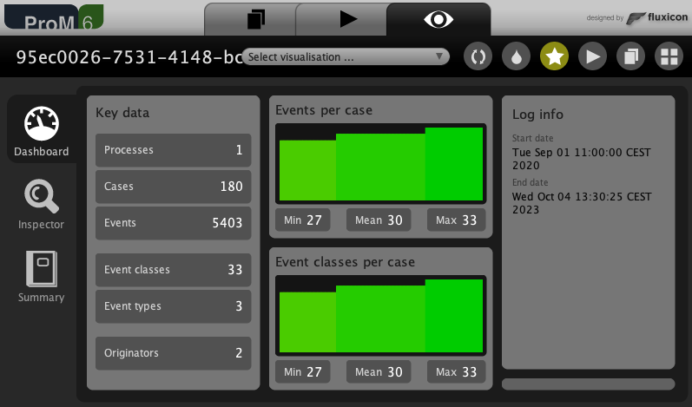
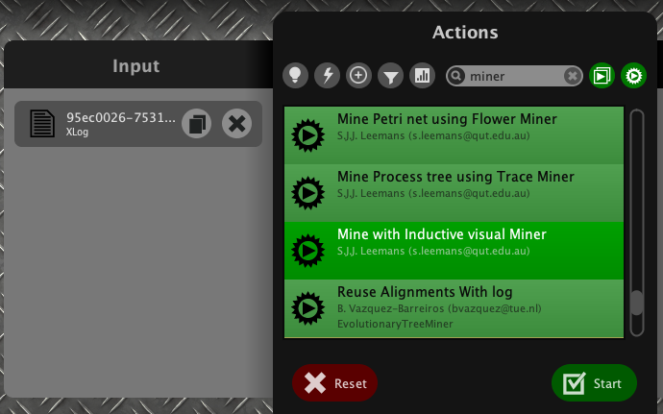
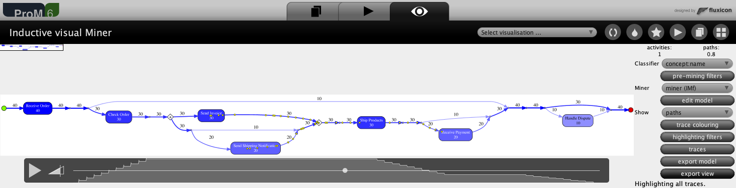
ProM
Log Visualization and Inspection
Process Mining Algorithm Selection
Log Animation

Slide 56
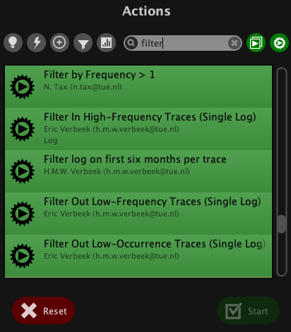
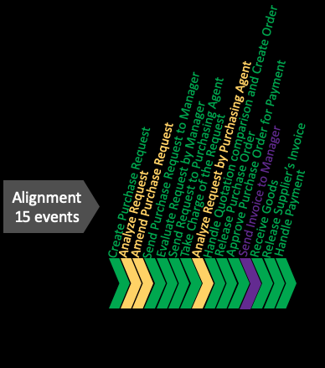
ProM
Filter a Log
Conformace Checking
Log move only
Model move only
Model & Log matching move

Slide 57
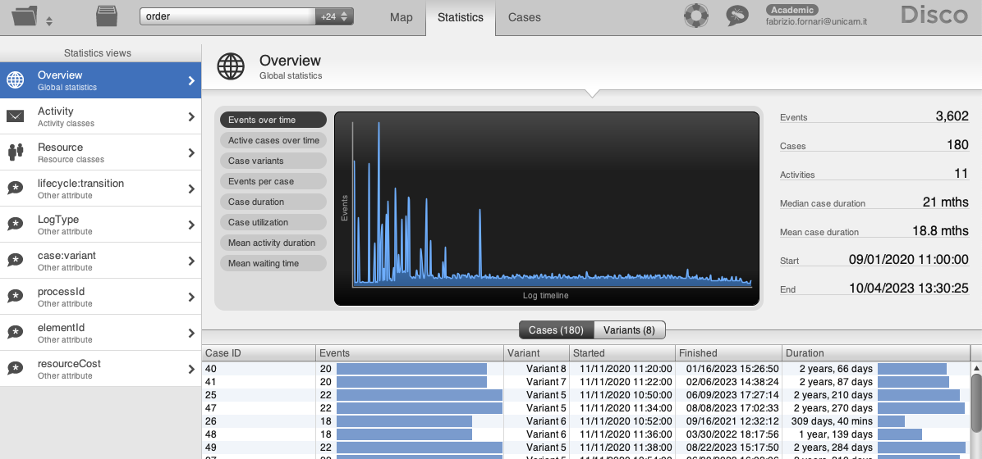
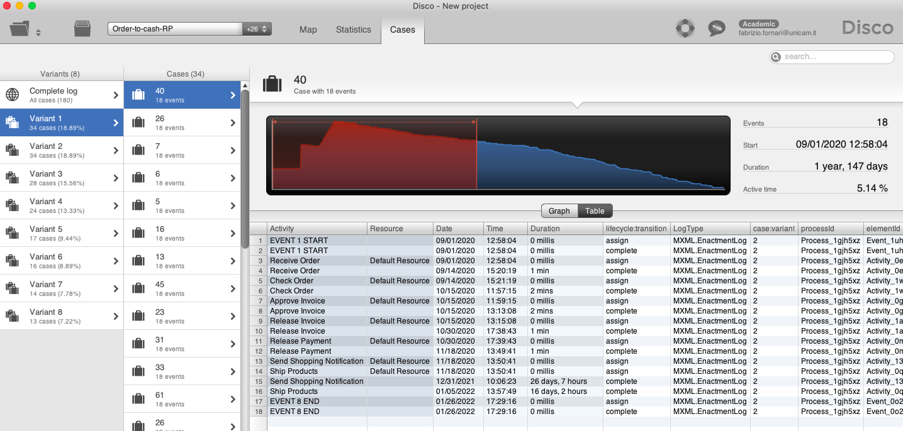
Disco - Log Overview

Slide 58
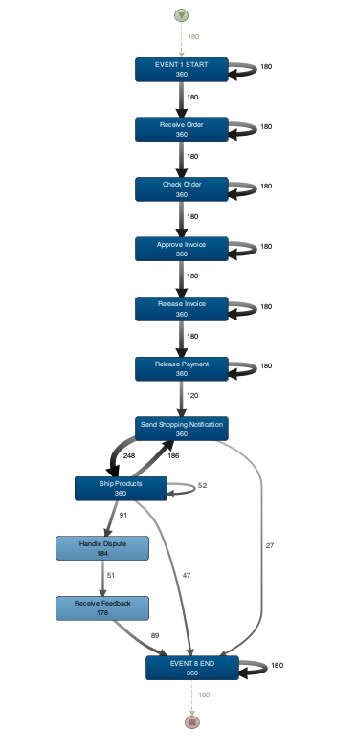
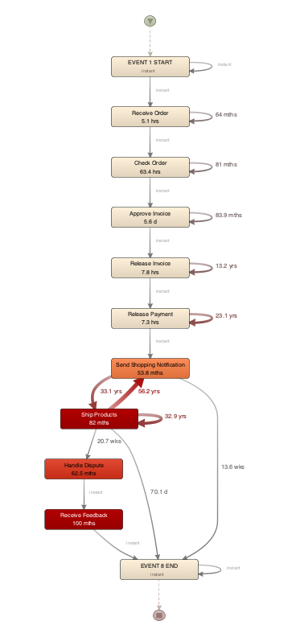
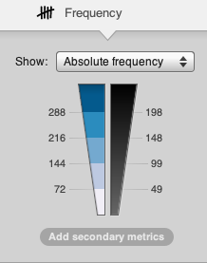
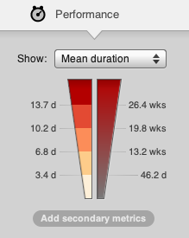
Disco Process Discovery

Slide 59
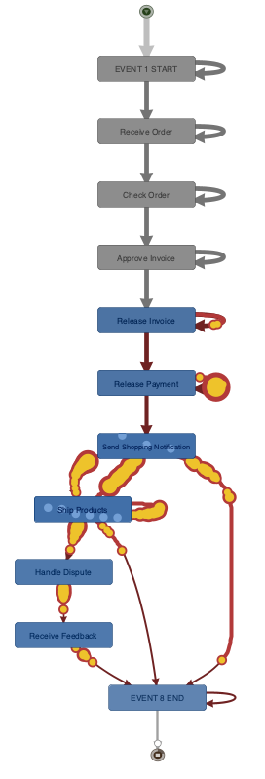
Disco – Log Animation
There is some congestion!

Slide 60
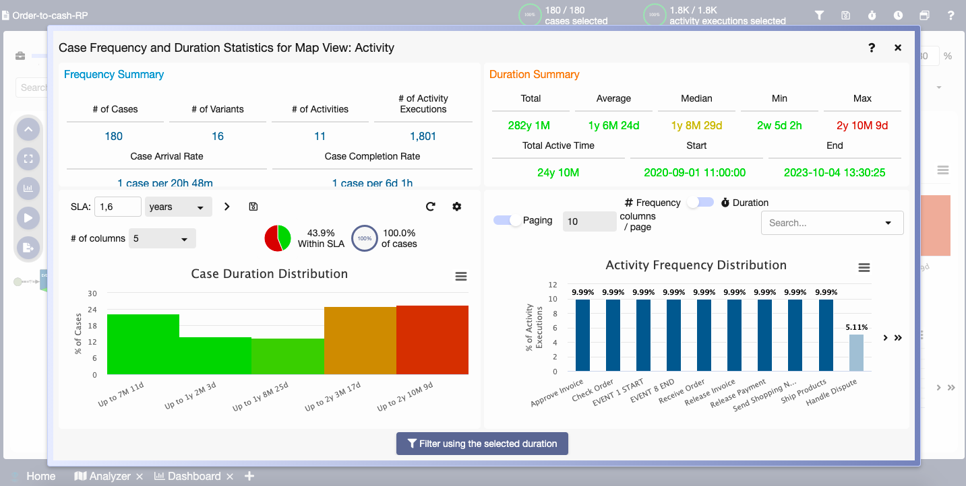
Process Diamond – Log Overview

Slide 61
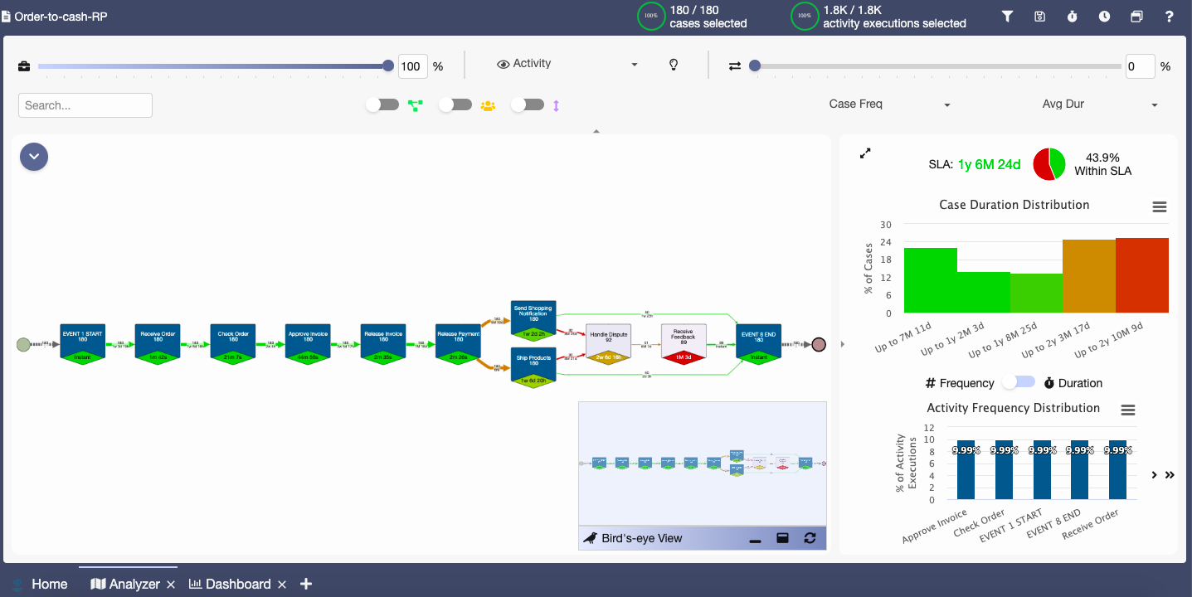
Process Diamond – Process Discovery

Slide 62
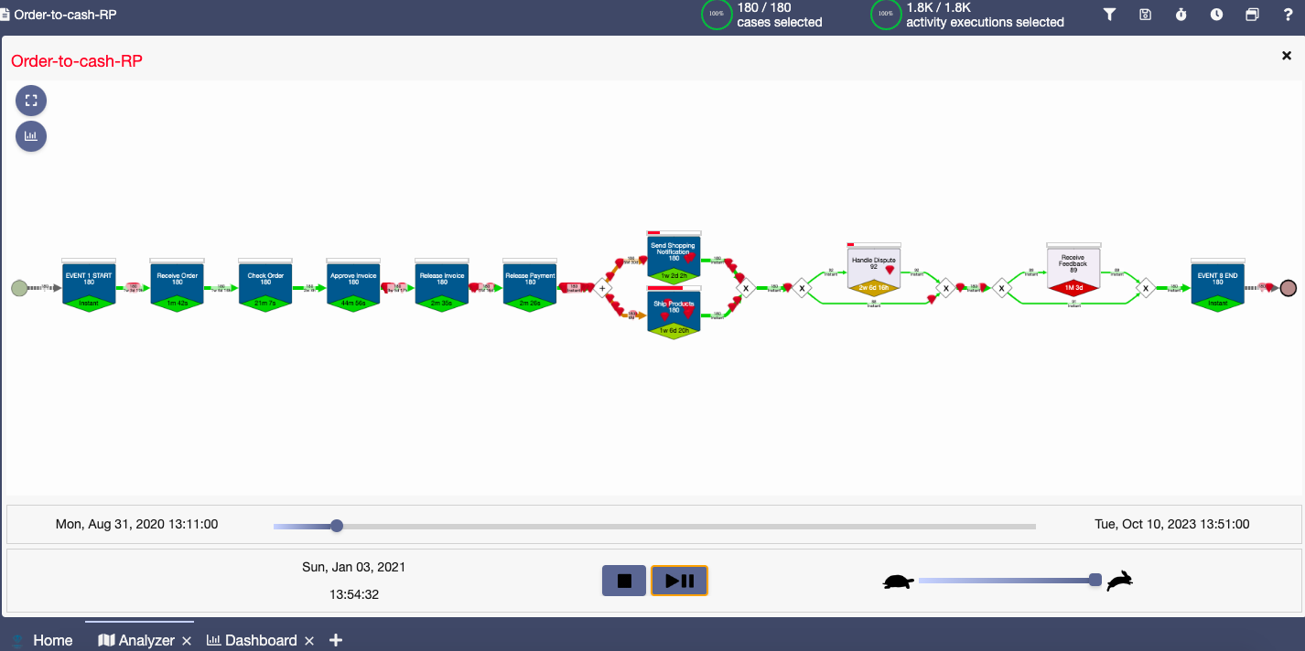
Process Diamond – Log Animation

Slide 63
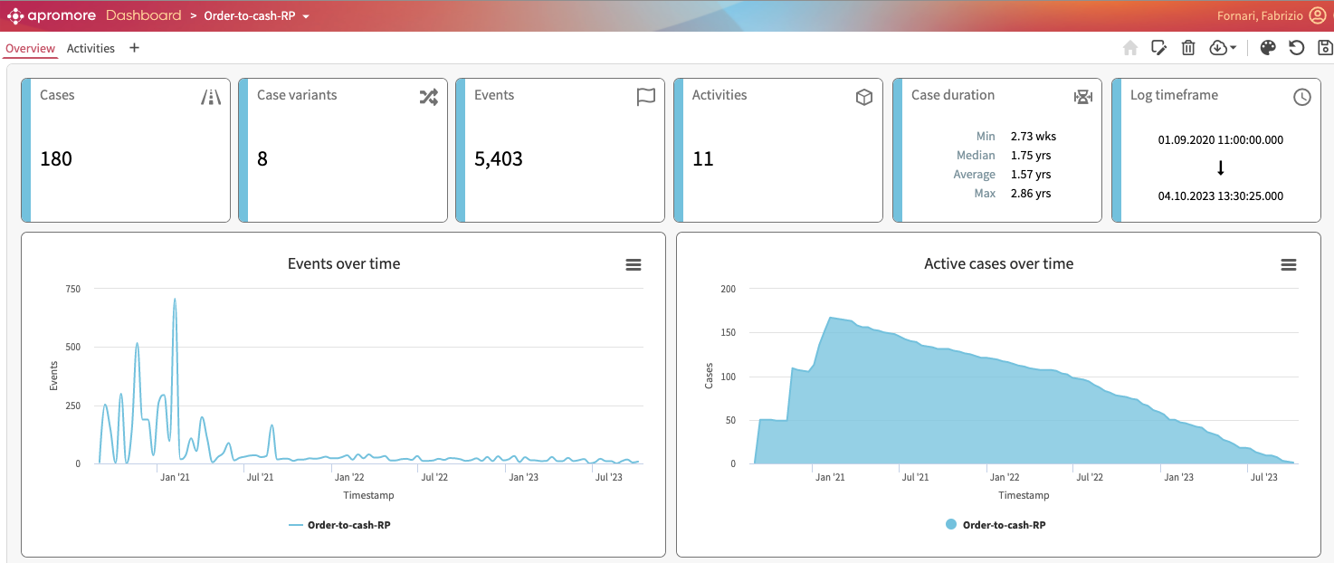
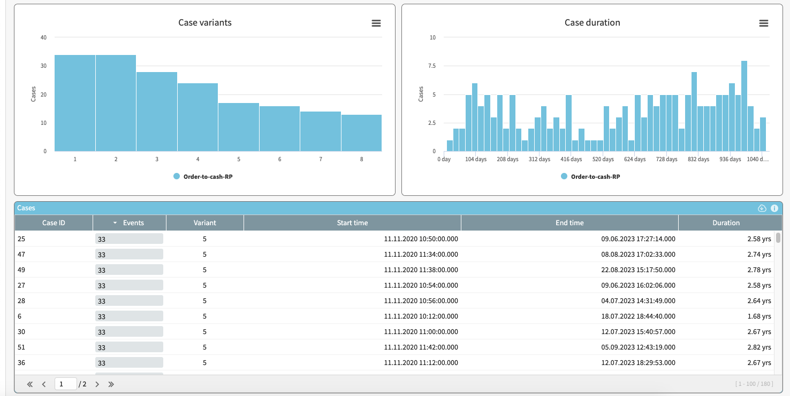
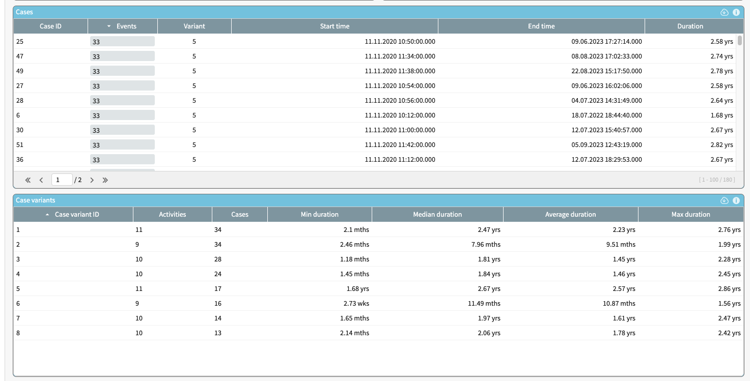
Apromore - Log Overview

Slide 64
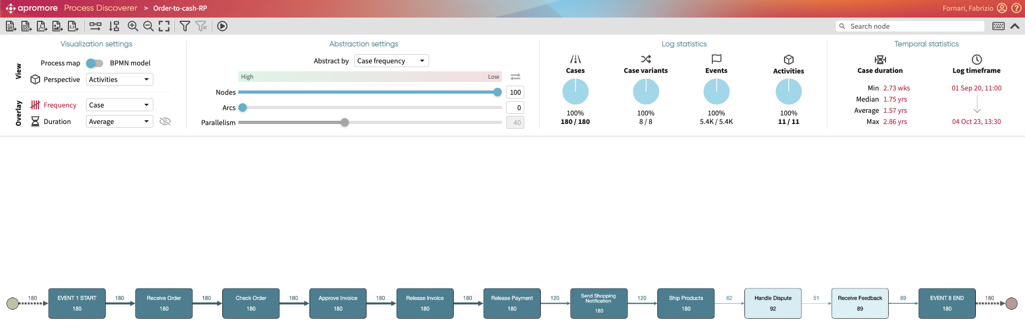
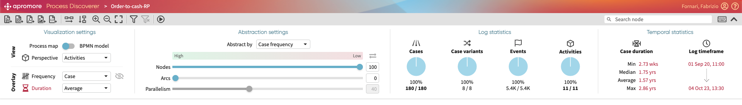
Apromore – Process Discovery

Slide 65
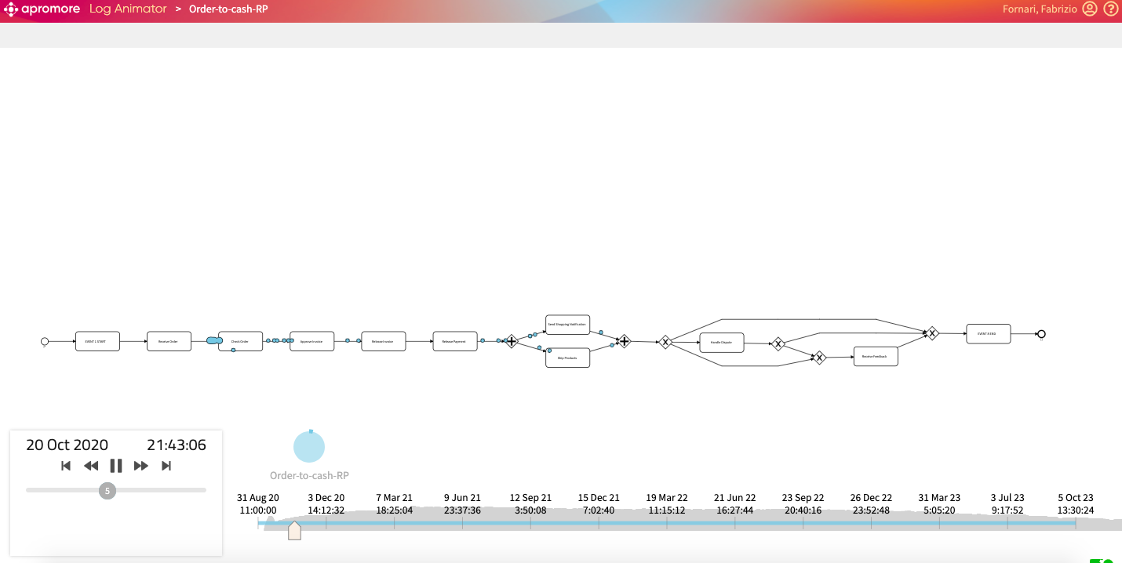
Apromore - Log Animation

Slide 66
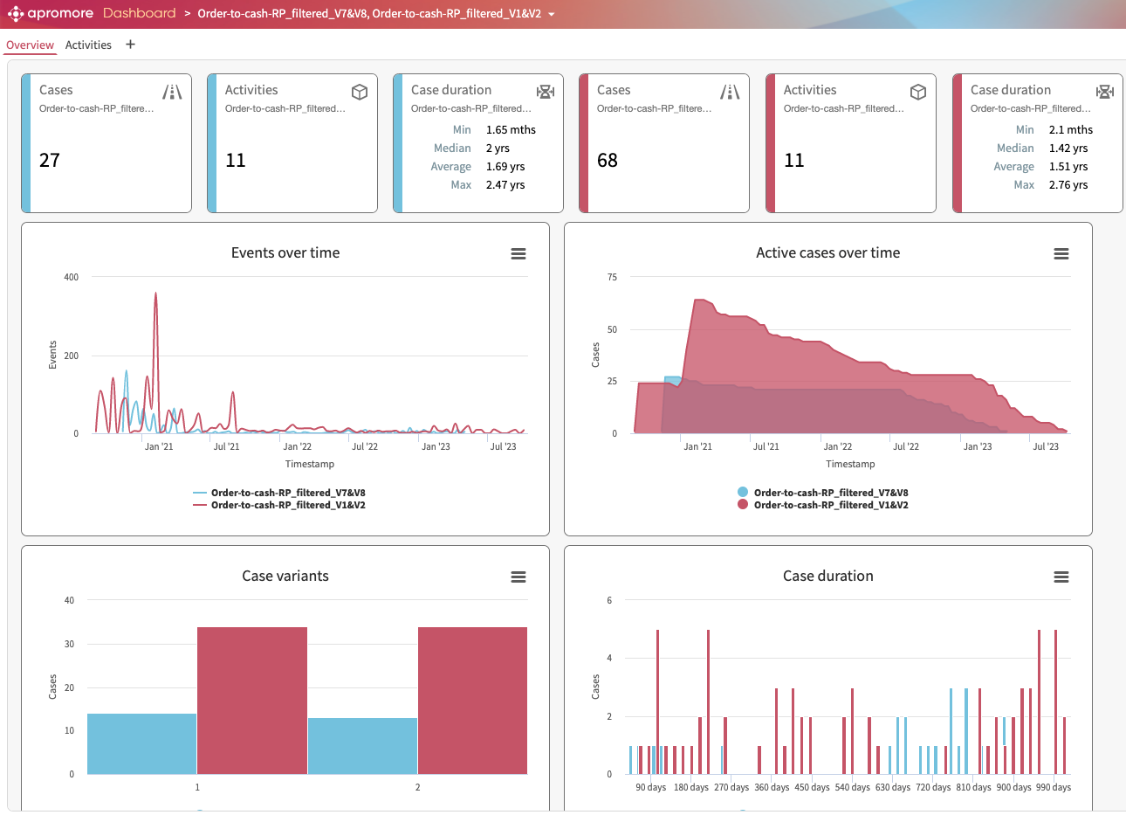
Apromore – Compare Logs

Slide 67
Apromore – Try it!
Apromore Academic node:
https://academic-eu.apromore.org/
1 Import a Log
2 Inspect the Log (Analyze --> View Performance Dashboard)
3 Discover a model (Double click over the Log)
4 Switch from Process Map to BPMN
5 Increase amount of arcs shown (Are some activities skipped?)
6 Switch from Frequency to Duration (Are there any bottlenecks?)
7 Filter the Log to see only one variant
8 Save the Filtered Log
9 Change the Filter to see another variant
10 Discover a model from the log Saved (at point 8)
Put models side by side (are there any visible differences?)
Select two Logs and Compare them (Analyze --> View Performance Dashboard)

Slide 68

Apromore – Compare Models

Slide 69
How to apply Process Mining?
I suggest you to try different Process Mining tools.
Find which one, or which comination, fits better your needs.
Start with Apromore https://academic-eu.apromore.org/login.zul (it does not require you to install anything)

Slide 70
Where can you access Models and Logs?
Process Mining.org http://www.processmining.org/logs/start
RePROSitory http://pros.unicam.it/reprository
data.4tu.nl https://data.4tu.nl/search?q=:keyword:%20%22Process%20Mining%22

Slide 71
Research Question Recap
Selected Questions
Which are the tools/libraries that allow to simulate a Business Process and to generate a simulated process log?
A company would like to improve its own business process. Which useful information are you able to extract from the process log that could be of interest for adjusting the process log https://pros.unicam.it:4200/guest/guest/logDetails/41_1609161961173_0134123110131934
Given a normative model and a log, does the model properly represent the reality reported in the log? model https://pros.unicam.it:4200/guest/guest/modelDetails/29_1609193931582_113221221424339 log https://pros.unicam.it:4200/guest/guest/logDetails/44_1609266632685_5729420920281533
Can we really trust the logs?
Discarded Questions
Which are the available tools/libraries for applying process mining techniques?
How to go from a sensor log to a process log?
RePROSitory is an academic platform for sharing models and logs. Practice with the platform and try to suggest possible improvements/features that in your opinion such a platform should incorporate. Practice with the platform http://pros.unicam.it/reprository and fill the questionnaire available at https://forms.gle/GwmKSsjAzdpKu3dX6

Slide 72
Two words on the discarded questions
Several Process Mining Software, Tools, and Libraries are being developed https://www.gartner.com/reviews/market/process-mining Software List by Gartner
https://pypi.org/project/pm4py/ Python library for Process Mining
Business Process Meets Internet of Things
In a world always more connected, IoT devices (e.g., sensors and actuators) are producing huge amount of data. How to go from those data callected into sensors logs to event logs suitable for applying Process Mining techniques is a challenge the community is facing.
Janiesch, C., Koschmider, A., Mecella, M., Weber, B., Burattin, A., Di Ciccio, C., ... & Zhang, L. (2020). The Internet of Things Meets Business Process Management: A Manifesto. IEEE Systems, Man, and Cybernetics Magazine, 6(4), 34-44.
BP-Meet-IoT 5th International Workshop on BP-Meet-IoT (affiliated with BPM 2021) http://www.pros.webs.upv.es/sites/bp-meet-iot2021/
RePROSitory (Repository of open PROcess models and logS) is a web-based and open repository of business process models and logs made available respectively in .bpmn and .xes format. «From the community, for the community and beyond» -F.F.
Corradini, F., Fornari, F., Polini, A., Re, B., & Tiezzi, F. (2019). RePROSitory: a Repository Platform for Sharing Business PROcess modelS. BPM (PhD/Demos), 2420, 149-153.

Slide 73
Slide References and Additional Material
- William of Ockham, the Occam’s Razor https://en.wikipedia.org/wiki/Occam's_razor
- Weske, M. (2007). Business process management: concepts, methods, technology. Springer.
- Hammer, M., & Champy, J. (2009). Reengineering the Corporation: Manifesto for Business Revolution, A. Zondervan.
- Marlon Dumas, M. L. R., & Jan Mendling, H. A. R. (2018). Fundamentals of Business Process Management.
- Van Der Aalst, W., Adriansyah, A., De Medeiros, A. K. A., Arcieri, F., Baier, T., Blickle, T., ... & Wynn, M. (2011, August). Process mining manifesto. In International Conference on Business Process Management (pp. 169-194). Springer, Berlin, Heidelberg.
- Process mining: a database of applications. Technical report, HSPI SpA-Management Consulting. 2021 https://www.hspi.it/wp-content/uploads/2020/01/HSPI_Process_Mining_Database2020.pdf
- Van Der Aalst, W., Adriansyah, A., De Medeiros, A. K. A., Arcieri, F., Baier, T., Blickle, T., ... & Wynn, M. (2011, August). Process mining manifesto. In International Conference on Business Process Management (pp. 169-194). Springer, Berlin, Heidelberg.
- Augusto, A., Conforti, R., Dumas, M., La Rosa, M., Maggi, F. M., Marrella, A., ... & Soo, A. (2018). Automated discovery of process models from event logs: Review and benchmark. IEEE transactions on knowledge and data engineering, 31(4), 686-705.
Video Courses, Tutorials and Books
- Van Der Aalst, W. (2016). Data science in action. In Process mining (pp. 3-23). Springer, Berlin, Heidelberg. https://www.springer.com/gp/book/9783662498507
- Van Der Aalst, W. on Coursera on Youtube
- Apromore Youtube Channel https://www.youtube.com/channel/UCnf70RG0X6SD_PrWdAPKITw
- Process Mining 101 With Apromore https://apromore.org/process-mining/
- Marlon Dumas youtube channel https://www.youtube.com/c/MarlonDumas/videos
- Jan Mendling youtube channel https://www.youtube.com/watch?v=vpAxkG_W1_w&ab_channel=JanMendling
- ProM Tutorial https://www.youtube.com/watch?v=MBxeUCPnLRk&list=PLxwiqnzGQJfQzhrKDQ-r6PlVr3EXu4HUQ
Useful Websites
- http://www.processmining.org/
- https://www.promtools.org/doku.php
- https://apromore.org/
- https://processdiamond.com/
- http://pros.unicam.it/reprository

Slide 74
References from Questions List
Turner, C. J., Tiwari, A., Olaiya, R., & Xu, Y. (2012). Process mining: from theory to practice. Business Process Management Journal.
Batyuk, A. Y., & Voityshyn, V. V. (2018). Process Mining: Applied Discipline and Software Implementations.
Jansen-Vullers, M., & Netjes, M. (2006, October). Business process simulation–a tool survey. In Workshop and Tutorial on Practical Use of Coloured Petri Nets and the CPN Tools, Aarhus, Denmark (Vol. 38).
Burattin, A. (2016, September). PLG2: Multiperspective Process Randomization with Online and Offline Simulations. In BPM (Demos) (pp. 1-6).
Abel, M. (2011). Lightning fast business process simulator. Master's thesis. Institute of Computer Science, University of Tartu.
BPI 2020 challenge winner: Pufahl, L., Hobeck, R., Binetruy, P., Chada, W., Digtiar, M., Gülle, K. J., ... & Weber, I. Performance, Variant, and Conformance Analysis of an Academic Travel Reimbursement Process.
Cervantes, A. A., van Beest, N. R., La Rosa, M., Dumas, M., & García-Bañuelos, L. (2017, October). Interactive and incremental business process model repair. In OTM Confederated International Conferences" On the Move to Meaningful Internet Systems" (pp. 53-74). Springer, Cham.
Fahland, D., & van der Aalst, W. M. (2015). Model repair—aligning process models to reality. Information Systems, 47, 220-243.
Suriadi, S., Andrews, R., ter Hofstede, A. H., & Wynn, M. T. (2017). Event log imperfection patterns for process mining: Towards a systematic approach to cleaning event logs. Information Systems, 64, 132-150.
Jagadeesh Chandra Bose, R. P., Mans, R. S., & van der Aalst, W. M. (2013). Wanna improve process mining results?: it’s high time we consider data quality issues seriously. BPM reports, 1302.
Pegoraro, M., & van der Aalst, W. M. (2019, June). Mining uncertain event data in process mining. In 2019 International Conference on Process Mining (ICPM) (pp. 89-96). IEEE.

Slide 75
Thank You!
Contacts:
fabrizio.fornari@unicam.it
fabrizio89.wordpress.com/
www.linkedin.com/in/fabriziofornari/

